Slide 1
Docker & Kubernetes Training Learn How To Build, Deploy, Run and Orchestrate Containers Dell
23-24-25 April, 2019
Albert Anthony

Slide 2
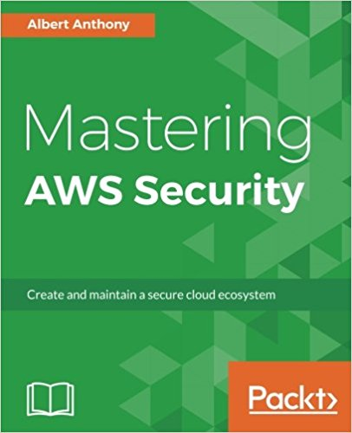
Introductions
Founder of Loves Cloud (www.loves.cloud)
Trainer – Cloud, DevOps & Containers
Author – Mastering AWS Security
Solution Architect & Consultant
Managed Kubernetes Service
Kubernetes on Bare Metal
AWS, Azure and GCP

Slide 3
Setting Expectations
Topics Covered
Overview of Docker
Overview of Kubernetes
9 Labs for Docker
11 Labs for Kubernetes
Learn Fundamental Concepts of Docker & Kubernetes
How to Deploy, Scale and Monitor Dockerized Applications on Kubernetes
Suitable for Developers, System Admins, Ops.

Slide 4
Pre-requisites
Familiarity with Docker
Familiarity with GitHub/GitLab
Resources/Pre-requisite:
Launching Your Own Server in Cloud
GitHub Account
Docker Hub Account
Software to Access Your Server on Cloud (ssh client)

Slide 5
Training Methodology
Less theory, more labs
Fully functional environment for all participants
Servers and software pre-installed
Hands-on labs for all topics
Team and individual assignments
Best Practices
Lab instructions document
Labs similar to real projects
All training material to be shared with participants
Training Feedback – Day 1 and Day 3

Slide 6
Training Schedule – Day 1
Introductions
Setting Expectations
Overview of Training
Docker
Docker Introduction
Docker Container & Images
Dockerfile
Docker Hub

Slide 7
Training Schedule – Day 2
Docker
Dockerize Java, .NET and Python Apps
Docker Compose
Kubernetes
Architecture and Key Terminologies
Kubernetes Dashboard
Deploy Dockerized Apps on K8 Cluster

Slide 8
Training Schedule – Day 3
Kubernetes
Ingress (Exposing Deployments)
Storage
Persistent Volumes
Scale Multi-Tier App
Horizontal Pod Autoscaler
Health Checks
Monitoring Kubernetes
Prometheus
Troubleshooting & Debugging
Best Practices
Docker
Kubernetes
Path Forward

Slide 9
Download Lab Instructions
https://github.com/albertlovescloud/delltraining

